Slide 1
END TO END WEB APP TO PREDICT SEVER DISEASES USING ML MODEL
HEALTH APP
LIVER DIEASES
HEART DIEASES
KIDNEY DIEASES
DIABETES
CANCER
SVASTHA
TEAM INNOVATORS

Slide 2
HEALTH APP
LIVER DIEASES
HEART DIEASES
KIDNEY DIEASES
DIABETES
CANCER
“ HEALTH IS NOT VALID UNLESS SICKNESS COMES ”
TEAM INNOVATORS

Slide 3
THREE STAGES OF DEVELOPMENT
STAGE 1
STAGE 2
STAGE 3
HEALTH APP
LIVER DIEASES
CANCER
HEART DIEASES
KIDNEY DIEASES
DIABETES
CREATING THE MODEL
CREATING THE API FOR EACH MODEL
DEPLOYING THE API INTO THE CLOUD AND INTEGRATING INTO SINGLE INTERFACE
TEAM INNOVATORS

Slide 4
KAGGLE DATASETS
SKLEARN
LIBRARIES &DATA SETS USED
JOBLIB
FLASK
HEALTH APP
LIVER DIEASES
HEART DIEASES
KIDNEY DIEASES
DIABETES
CANCER
01
02
03
04
TEAM INNOVATORS

Slide 5
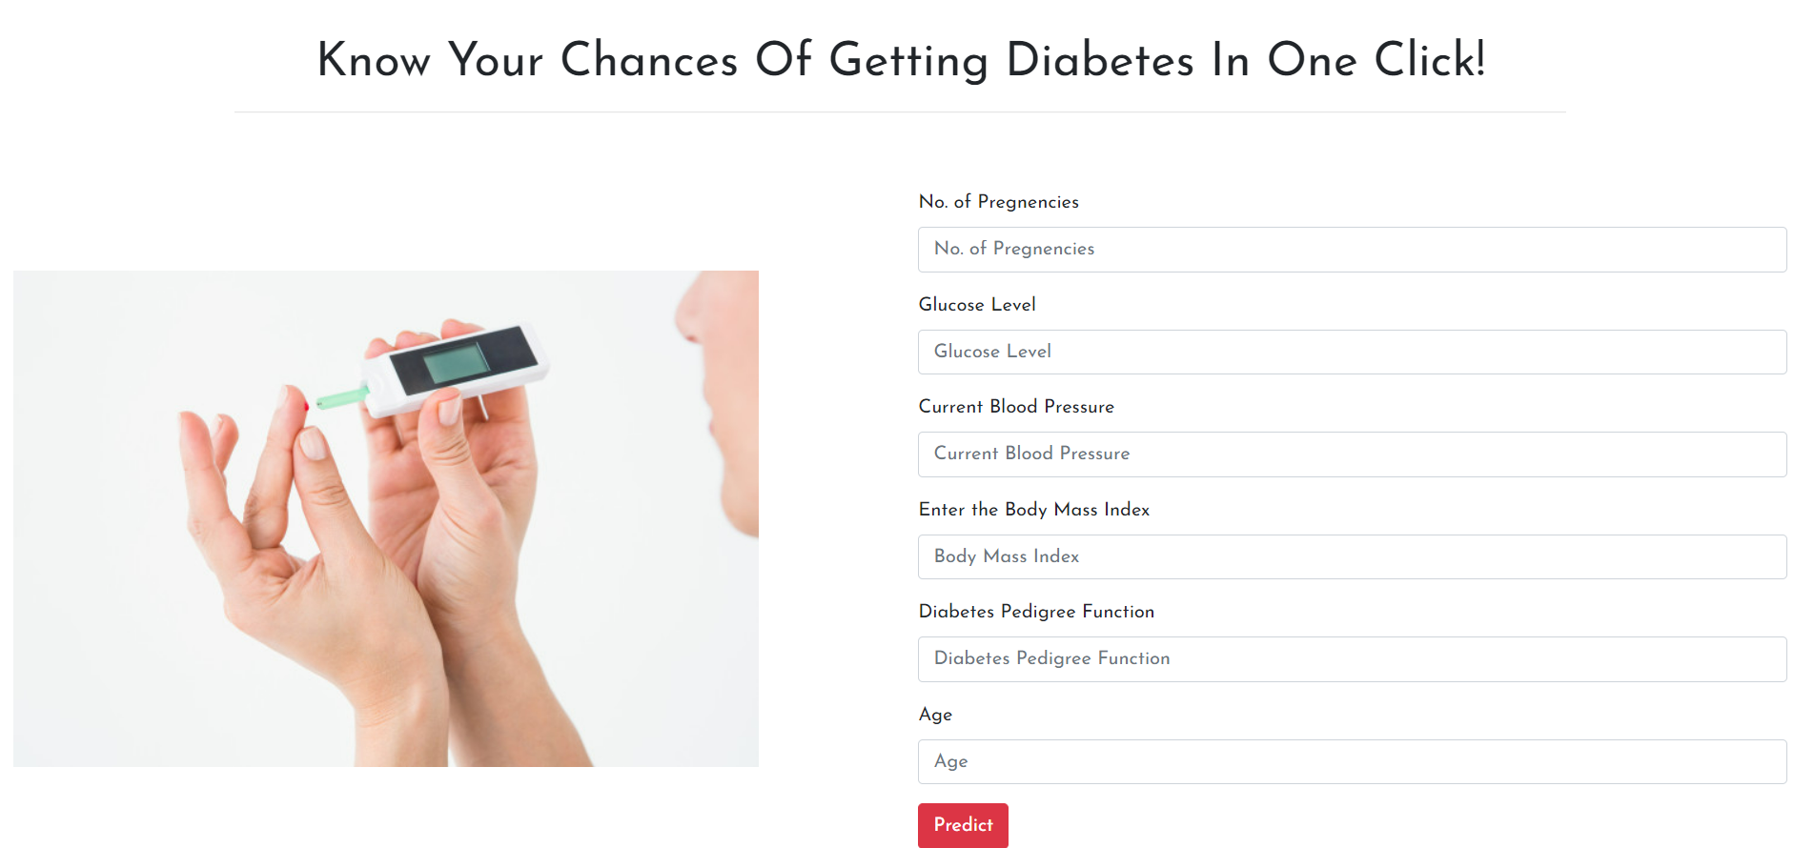
HEALTH APP
LIVER DIEASES
CANCER
HEART DIEASES
KIDNEY DIEASES
DIABETES
TEAM INNOVATORS

Slide 6

BUSINESS IDEAS
DIABETES
HEALTH APP
LIVER DIEASES
HEART DIEASES
KIDNEY DIEASES
CANCER
TEAM INNOVATORS

Slide 7
THANK YOU…!
HEALTH APP
LIVER DIEASES
HEART DIEASES
KIDNEY DIEASES
DIABETES
CANCER
SVASTHA
TEAM INNOVATORS

